Slide 1

Windows PowerShell
System administration and automation in a Windows environment
- The navigation model -
Karin De Maertelaere, Jochen Mariën
Notes:
Test-path
Push and pop-location

Slide 2
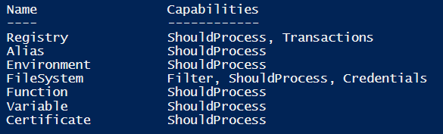
What are providers?
Get-PSProvider
A PSProvider is an adapter that allows a data store to be accessed like a disk drive
What is possible?
Ask user confirmation: -Shouldprocess, -Whatif, -Confirm
Filtering: -Filter
Credentials: -Credential
Transactions: several changes can be reversed or committed in one act

Slide 3
Terminology
Not File and Folder but Generic terms
Item: reference to individual object
eg: file, folder, registry key, variable, …
Itemproperty: reference to the attribute of an item
eg: read-only, creation time, length, …

Slide 4
Wildcards
Wildcards:
*: 0 or more characters
?: 1 character
\: Root directory
. : Current directory
.. : Parent directory
~ : Home directory of the current user
[] : 1 or more characters between the brackets
When you want to use * and ? in a name?
Use -LiteralPath
This parameter does not accept wildcards

Slide 5
Core commands – using them
 | File system |  | Register |  | Aliases | Environment variables | Functions
 | Folder | File | Key | Key value
Get-Item | x | x | x |  | x | x | x
Set-Item |  |  | x |  | x | x | x
Get-ItemProperty | x | x |  | x | - | - | -
Set-ItemProperty |  |  |  | x | - | - | -
New-Item | -itemtype directory | -itemtype file | x |  | x | x | x
Notes:
The navigation cmdlets support a lot of functions, but not each function works in every data store
-usetransaction doesn’t work in filesystem
-filter doesn’t work in registry
itemproperty doesn’t work in environment provider
Folder or directory: new-item xxx –itemtype directory
File: new-item yyy –itemtype file
Key: new-item zzz (er zijn hier enkel sleutels mogelijk, dus er hoeft geen itemtype worden vermeld)
Key value: new-itemproperty

Slide 6
Uniform navigation model
Get-PSDrive, shows “drives”:
Drives
Environment variables (env)
Registry (HKCU, HKLM)
Certificates (cert )
Aliases
Variables
Functions
WSMan (V2)
On a Domain Controller:
AD (ActiveDirectory)
Get-PSDrive
Set-Location wsman:
Set-Location .\localhost
Set-Location Function:

Slide 7
Creating drives
A network drive (the old net use…)
Shows up in explorer if the name is a single character
A new drive
Never shows up in explorer
Only exists in current PowerShell-process
$cred = Get-Credential
New-PSDrive -name V -PSProvider FileSystem `
-root \\myserver\vd -Persist -Credential $cred
New-PSDrive -PSProvider FileSystem -Name temp -Root c:\tmp
Set-Location temp:

Slide 8
…-Path cmdlets
Get-Command -Noun Path
Test-Path c:\tmp
Resolve-Path ..
Resolve-Path ..\tmp
Resolve-Path ~ | Get-Member
Convert-Path ~ | get-member # or
(Resolve-Path ~ ).Path # or
Resolve-Path ~ | Select-Object -ExpandProperty path
Join-Path "c:" "a folder"
Join-Path "c:\" “\a folder"
$docs = Get-Item ( Join-Path ~ "Documents")
Split-Path $docs.FullName -Parent
Split-Path $docs.FullName -Leaf
Split-Path $docs.FullName -Qualifier
Split-Path ( Join-Path $docs.FullName "*.txt") -Resolve -Parent

Slide 9
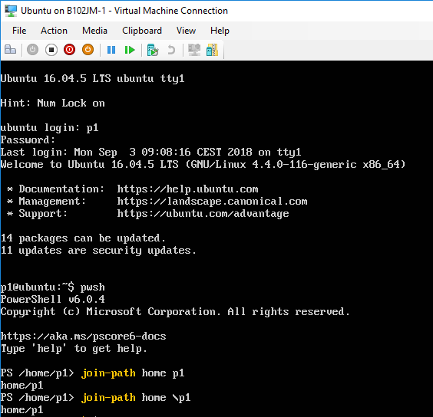
In PowerShell core

Slide 10
Push and pop
Push:
Save current location in stack (on top)
Move to given location
Pop:
Move to location on top of stack
Set-Location c:\tmp
Push-Location C:\Windows
Push-Location "C:\Program Files"
Pop-Location
Pop-Location
Notes:
https://technet.microsoft.com/library/hh849855.aspx
https://technet.microsoft.com/en-us/library/hh849842.aspx

Slide 11
Childitems (e.g. A folder)
Get-ChildItem c:\windows -Directory
Get-ChildItem c:\windows -File
Get-ChildItem c:\windows -Hidden
Get-ChildItem C:\Windows -System -ReadOnly
# Great, but only and (not or)
gci c:\windows -ad
gci c:\windows -af
gci c:\windows -ah
gci C:\Windows -as -ar
# operators !(NOT), +(AND), ,(OR)
# All attributes: D - directory, H - Hidden, R - Read-only, S - System
Get-ChildItem c:\ -Attributes d
Get-ChildItem c:\ -Attributes d+r
Get-ChildItem c:\ -Attributes d+!r
Get-ChildItem c:\ -Attributes !d
Get-childitem c:\ -Attributes d+!r,!d
Get-ChildItem c:\ -Attributes directory+!readonly,!directory

Slide 12
Filtering
Path is the path to start looking in
Filter, include and exclude can be used to filter
All accept wildcards
Recurse and Depth (5.0) can be used to search recursively
Recurse only works in PS 2.0 when the filter isn’t in the path
Get-ChildItem C:\tmp -Filter *.txt -Recurse
Get-ChildItem C:\tmp -Include *.txt -Recurse
Get-ChildItem C:\tmp -Exclude *.txt -Recurse
Get-ChildItem c:\tmp\*.txt -Recurse
Notes:
New-Item c:\tmp\tmp1.txt -Force
New-Item c:\tmp\folder\tmp2.txt -Force
New-Item c:\tmp\folder\tmp3.txt -Force

Slide 13
An item (e.g. A file)
New-Item -Path c:\tmp\tmp.txt -ItemType File –Force # force overwrites existing file
Copy-Item -Path c:\tmp\tmp.txt -Destination c:\tmp\tmp2.txt
Move-Item -Path c:\tmp\tmp.txt -Destination c:\tmp\tmp3.txt
Rename-Item -Path c:\tmp\tmp3.txt -NewName c:\temp\tmp4.txt # rename doesn't move
$item = Get-Item -Path c:\tmp\tmp2.txt
$item.FullName
$item.Extension
$item.Name

Slide 14
Itemproperties – the old & hard way
Get-ItemProperty c:\tmp\tmp.txt -name attributes
# Setting attributes
Set-ItemProperty c:\tmp\tmp.txt -Name attributes -Value ( `
[System.IO.FileAttributes]::ReadOnly -bor `
[System.IO.FileAttributes]::Archive)
# Adding attributes
Set-ItemProperty tmp.txt -Name attributes -value ( `
(Get-ItemProperty tmp.txt).attributes -bxor `
[System.IO.FileAttributes]::hidden)
# Testing for attributes
if ((Get-ItemProperty c:\tmp\tmp.txt).Attributes `
-band [System.IO.FileAttributes]::hidden)
{
write-host -ForegroundColor green "Hidden attribute set"
}

Slide 15
Itemproperties – the old & hard way
# Removing attributes
Set-ItemProperty c:\tmp\tmp.txt -Name attributes -value ( `
(Get-ItemProperty c:\tmp\tmp.txt).attributes -bxor `
[System.IO.FileAttributes]::hidden)
# or...
Set-ItemProperty c:\tmp\tmp.txt -Name attributes -value 0

Slide 16
Itemproperties – the new & easy way
Check out the itemproperties in shorthand with mode
Get-Item "C:\Windows\system32\rundll32.exe" | Format-Table Name,Mode
Get-ChildItem "C:\" -Force | Format-Table Name,Mode
# Get "tmp.txt"
$a = Get-Item c:\tmp\tmp.txt
# Replace its atribute set with archive and read-only
$a.Attributes ="Archive","ReadOnly"
# Add and remove "hidden" to it
$a.Attributes += "Hidden"
$a.Attributes -= "Hidden"
#Remove all attributes
$a.Attributes = "Normal"
Notes:
Source: https://confidentialfiles.wordpress.com/2019/02/05/the-easy-way-to-work-with-file-attributes-in-powershell/

Slide 17
Littering the registry
Set-Location hklm:\software
New-Item labo
New-Item -Name "ICT" -Value "ICT services and management" -ItemType string
Get-Item hklm:\software\ICT
Get-ChildItem hklm:\software
New-ItemProperty –path "hklm:\software\ICT" –name "Owner" `
-value "Devops" –type string
New-ItemProperty –path "hklm:\software\ICT" –name "Starting year" `
-value 1997 –type DWord

Slide 18
Littering the registry
New-ItemProperty –path "hklm:\software\ICT" –name "Sites" `
-value "www.cello.be", "www.thomasmore.be" –type multistring
Get-ItemProperty ICT
New-PSDrive –Name Software –PSProvider Registry `
-root HKLM:\Software\Microsoft\Windows\CurrentVersion\Uninstall
Set-Location Software:
Convert-Path .
Get-ChildItem -LiteralPath HKLM:\SOFTWARE\Classes\*

Slide 19
Environment variables
about_Environment_Variables
https://technet.microsoft.com/en-us/library/hh847808.aspx
Store information about the operating system
The provider:
Reading the value
$env:path -> System.String
Get-ChildItem env:path -> System.Collections.DictionaryEntry
Read: Creating and Modifying Environment Variables
https://technet.microsoft.com/en-us/library/ff730964.aspx
Set-location Env:

Slide 20
Cmdlets that have “Item” in them…
Get-Command -noun *item* | where {$_.CommandType -eq "cmdlet"}
Lots of controlpanel-cmdlets:
For when you want to script using the GUI
Get-ControlPanelItem
Get-ControlPanelItem -Name "Autoplay" | format-list *
Get-ControlPanelItem -name "Windows Defender FireWall" | Show-ControlPanelItem
Get-ControlPanelItem -CanonicalName Microsoft.Display |
Show-ControlPanelItem
appwiz
Get-ChildItem C:\Windows\SysWOW64 -Recurse *.cpl
Get-ChildItem C:\Windows -Recurse *.cpl
desk

Slide 21
